Slide 1


Slide 2
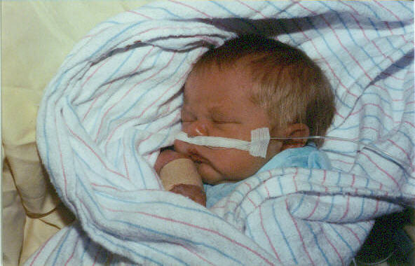

Slide 3


Slide 4

Doubt not Desertion

Slide 5
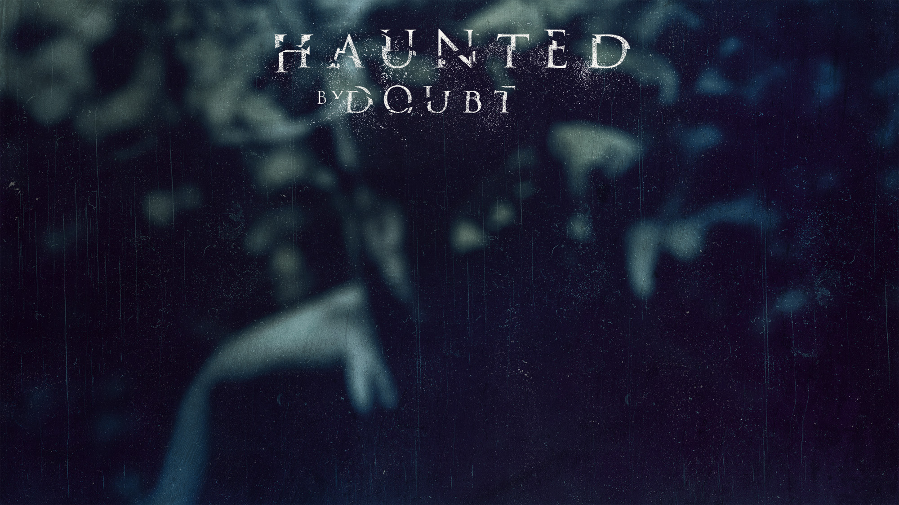
TOOL
TRAIT
TRUST

Slide 6
TOOL
TRAIT
TRUST

Slide 7

TOOL OF SATAN
Genesis 3:1 Now the serpent was more crafty than any beast of the field which the LORD God had made. And he said to the woman, “Indeed, has God said, ‘You shall not eat from any tree of the garden’?” ² The woman said to the serpent, “From the fruit of the trees of the garden we may eat; ³ but from the fruit of the tree which is in the middle of the garden, God has said, ‘You shall not eat from it or touch it, or you will die.’”

Slide 8
TOOL OF SATAN
Philippians 4:6 Be anxious for nothing, but in everything by prayer and supplication with thanksgiving let your requests be made known to God. ⁷ And the peace of God, which surpasses all comprehension, will guard your hearts and your minds in Christ Jesus.

Slide 9
TOOL OF SATAN
2 Timothy 1:7
For God has not given us a spirit of timidity, but of power and love and discipline.

Slide 10
Doubt, Worry & Fear are tools used by Satan to stop the saints

Slide 11
TOOL
TRAIT
TRUST

Slide 12

Benedict Arnold
Richard Nixon
Bernie Madoff

Slide 13
King David
Job
Jezebel
Ananias & Sapphira
Thomas

Slide 14
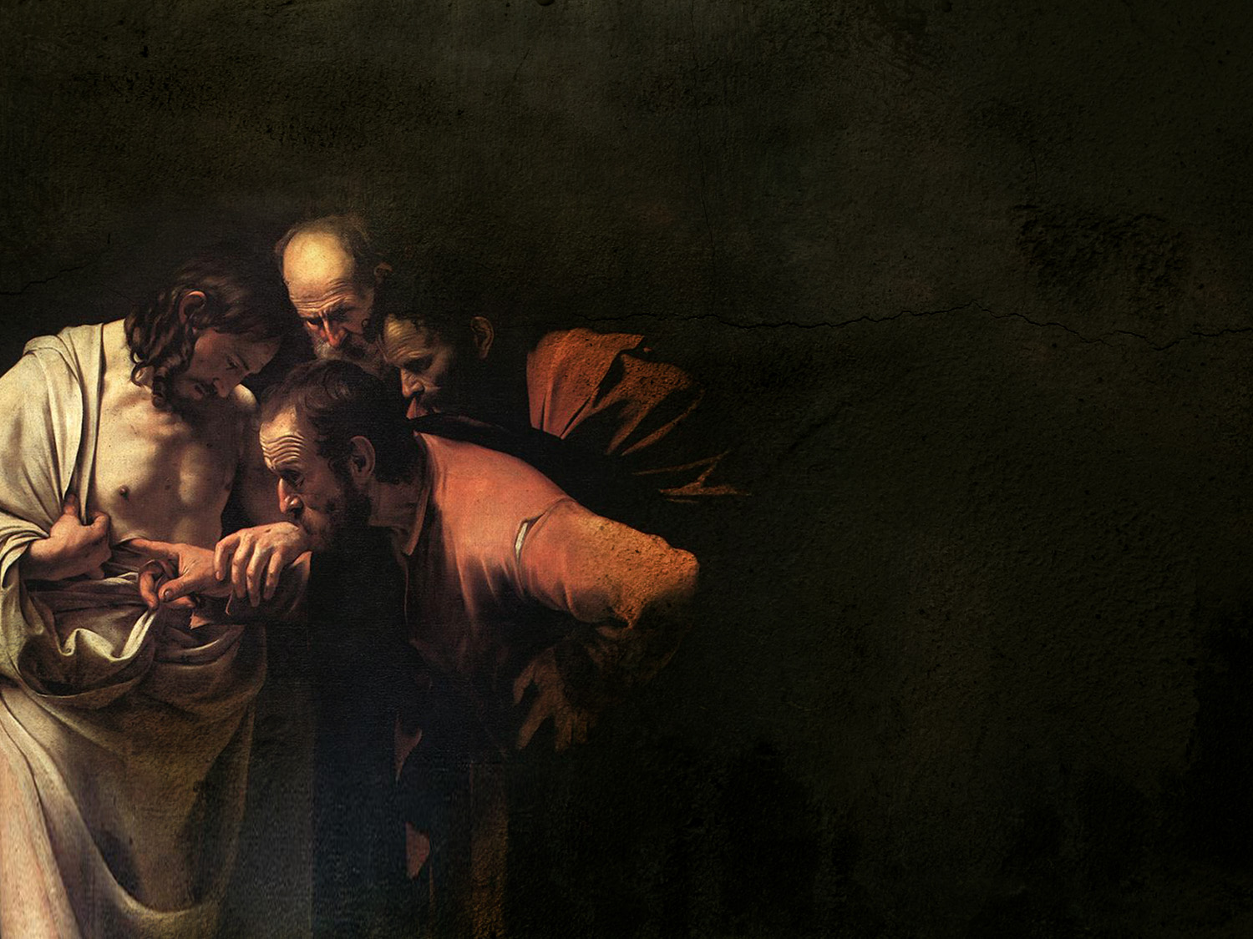
Seeing
the
Scars
John 20:19-31

Slide 15


Slide 16
Luke 24:10-12
10 Now they were Mary Magdalene and Joanna and Mary the mother of James; also the other women with them were telling these things to the apostles. 11 But these words appeared to them as nonsense, and they would not believe them. 12 But Peter got up and ran to the tomb; stooping and looking in, he saw the linen wrappings only; and he went away to his home, marveling at what had happened. NASU

Slide 17
John 20:6-10
6 And so Simon Peter also came, following him, and entered the tomb; and he saw the linen wrappings lying there, 7 and the face-cloth which had been on His head, not lying with the linen wrappings, but rolled up in a place by itself. 8 So the other disciple who had first come to the tomb then also entered, and he saw and believed. 9 For as yet they did not understand the Scripture, that He must rise again from the dead.
NASU

Slide 18
Mark 16:9-13
9 Now after He had risen early on the first day of the week, He first appeared to Mary Magdalene, from whom He had cast out seven demons. 10 She went and reported to those who had been with Him, while they were mourning and weeping. 11 When they heard that He was alive and had been seen by her, they refused to believe it.
12 After that, He appeared in a different form to two of them while they were walking along on their way to the country. 13 They went away and reported it to the others, but they did not believe them either.
NASU

Slide 19
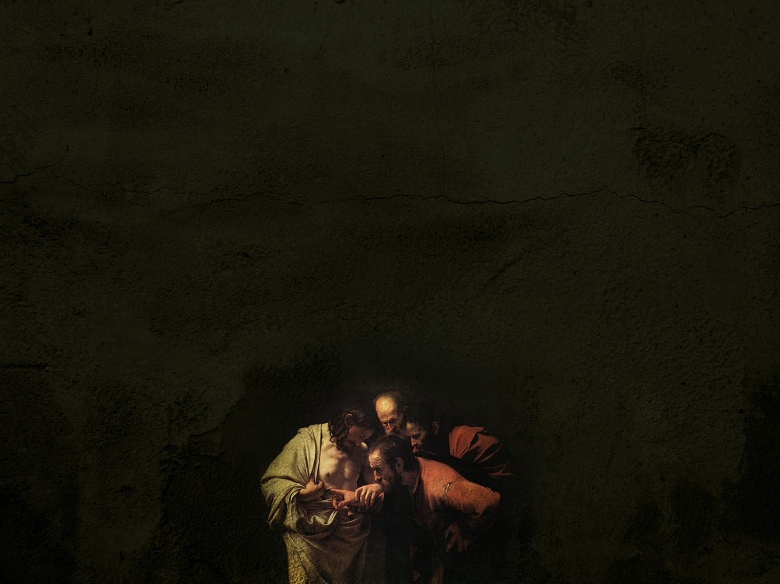
John 20:19-23
19 So when it was evening on that day, the first day of the week, and when the doors were shut where the disciples were, for fear of the Jews, Jesus came and stood in their midst and said to them, "Peace be with you." 20 And when He had said this, He showed them both His hands and His side. The disciples then rejoiced when they saw the Lord. 21 So Jesus said to them again, "Peace be with you; as the Father has sent Me, I also send you." 22 And when He had said this, He breathed on them and said to them, "Receive the Holy Spirit. 23 "If you forgive the sins of any, their sins have been forgiven them; if you retain the sins of any, they have been retained.” NASU

Slide 20
Luke 24:36-43
36 While they were telling these things, He Himself stood in their midst and said to them, "Peace be to you." 37 But they were startled and frightened and thought that they were seeing a spirit. 38 And He said to them, "Why are you troubled, and why do doubts arise in your hearts? 39 "See My hands and My feet, that it is I Myself; touch Me and see, for a spirit does not have flesh and bones as you see that I have." 40 And when He had said this, He showed them His hands and His feet. 41 While they still could not believe it because of their joy and amazement, He said to them, "Have you anything here to eat?" 42 They gave Him a piece of a broiled fish; 43 and He took it and ate it before them. NASU

Slide 21
John 20:19-23
19 So when it was evening on that day, the first day of the week, and when the doors were shut where the disciples were, for fear of the Jews, Jesus came and stood in their midst and said to them, "Peace be with you." 20 And when He had said this, He showed them both His hands and His side. The disciples then rejoiced when they saw the Lord. 21 So Jesus said to them again, "Peace be with you; as the Father has sent Me, I also send you." 22 And when He had said this, He breathed on them and said to them, "Receive the Holy Spirit. 23 "If you forgive the sins of any, their sins have been forgiven them; if you retain the sins of any, they have been retained.” NASU

Slide 22
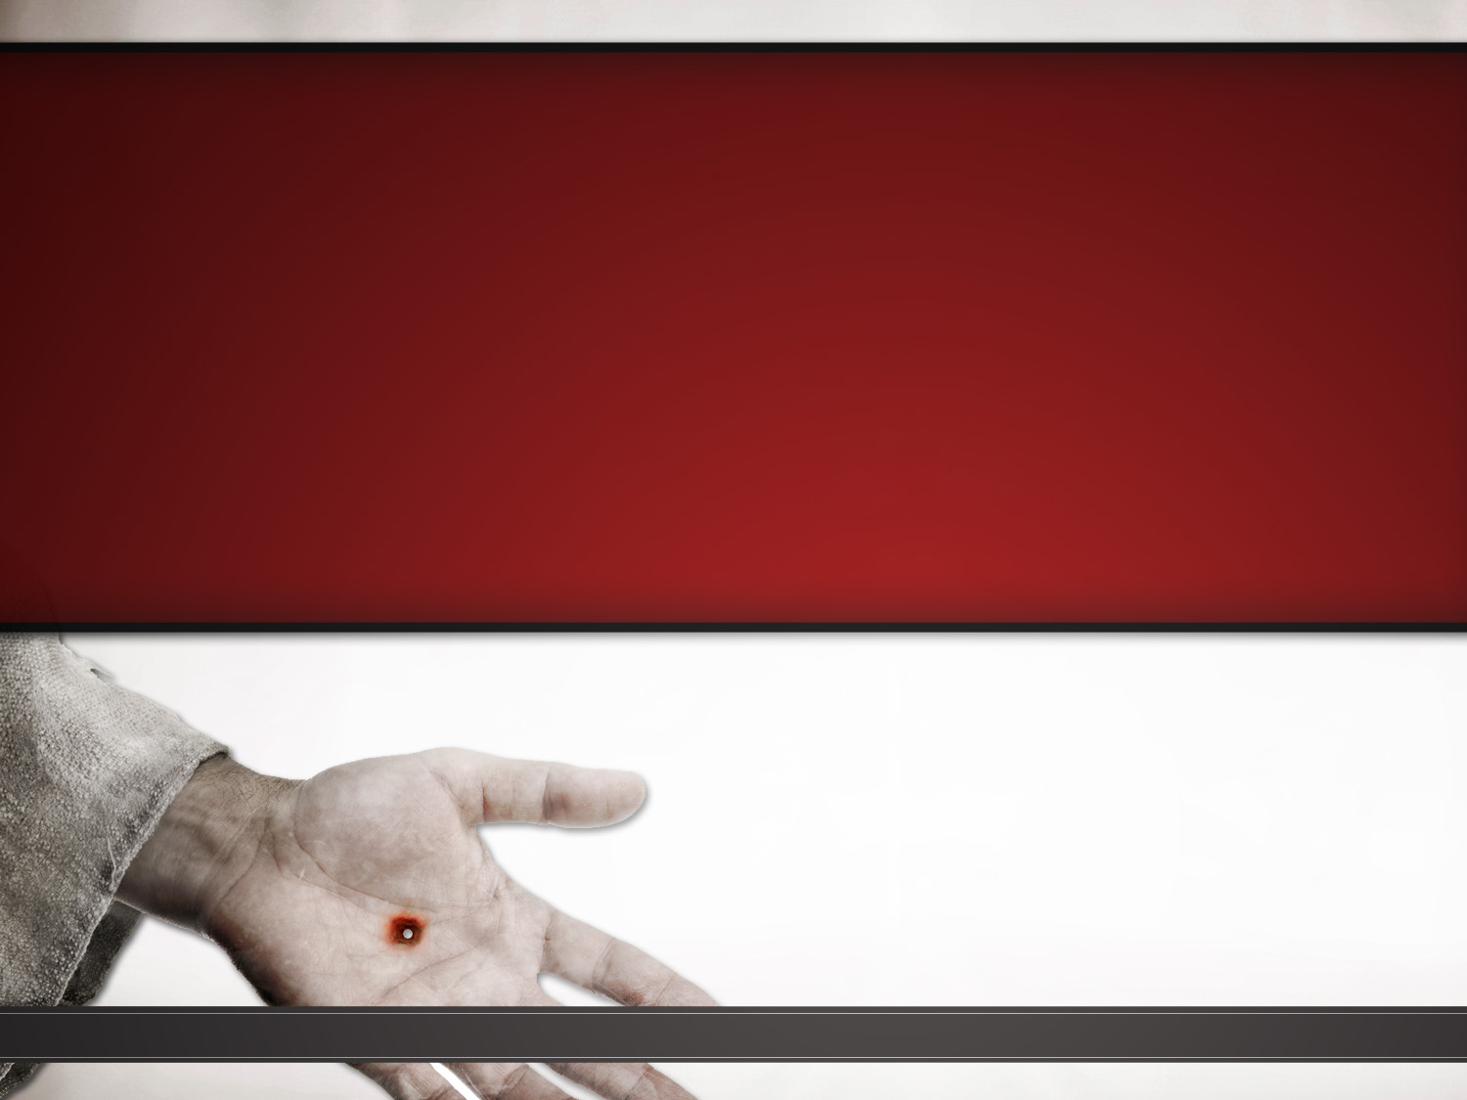
John 20:24-25 24 But Thomas, one of the twelve, called Didymus, was not with them when Jesus came. 25 So the other disciples were saying to him, "We have seen the Lord!" But he said to them, "Unless I see in His hands the imprint of the nails, and put my finger into the place of the nails, and put my hand into His side, I will not believe." NASU

Slide 23
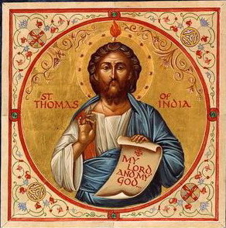
Doubting
Thomas?
John 11:16 Therefore Thomas, who is called Didymus, said to his fellow disciples, "Let us also go, so that we may die with Him." NASU
John 14:5-6
5 Thomas said to Him, "Lord, we do not know where You are going, how do we know the way?" 6 Jesus said to him, "I am the way, and the truth, and the life; no one comes to the Father but through Me.”

Slide 24
John 20:24-25 24 But Thomas, one of the twelve, called Didymus, was not with them when Jesus came. 25 So the other disciples were saying to him, "We have seen the Lord!" But he said to them, "Unless I see in His hands the imprint of the nails, and put my finger into the place of the nails, and put my hand into His side, I will not believe." NASU

Slide 25
HEROES OF FAITH
ABRAHAM
DAVID
APOSTLES

Slide 26
TOOL
TRAIT
TRUST

Slide 27
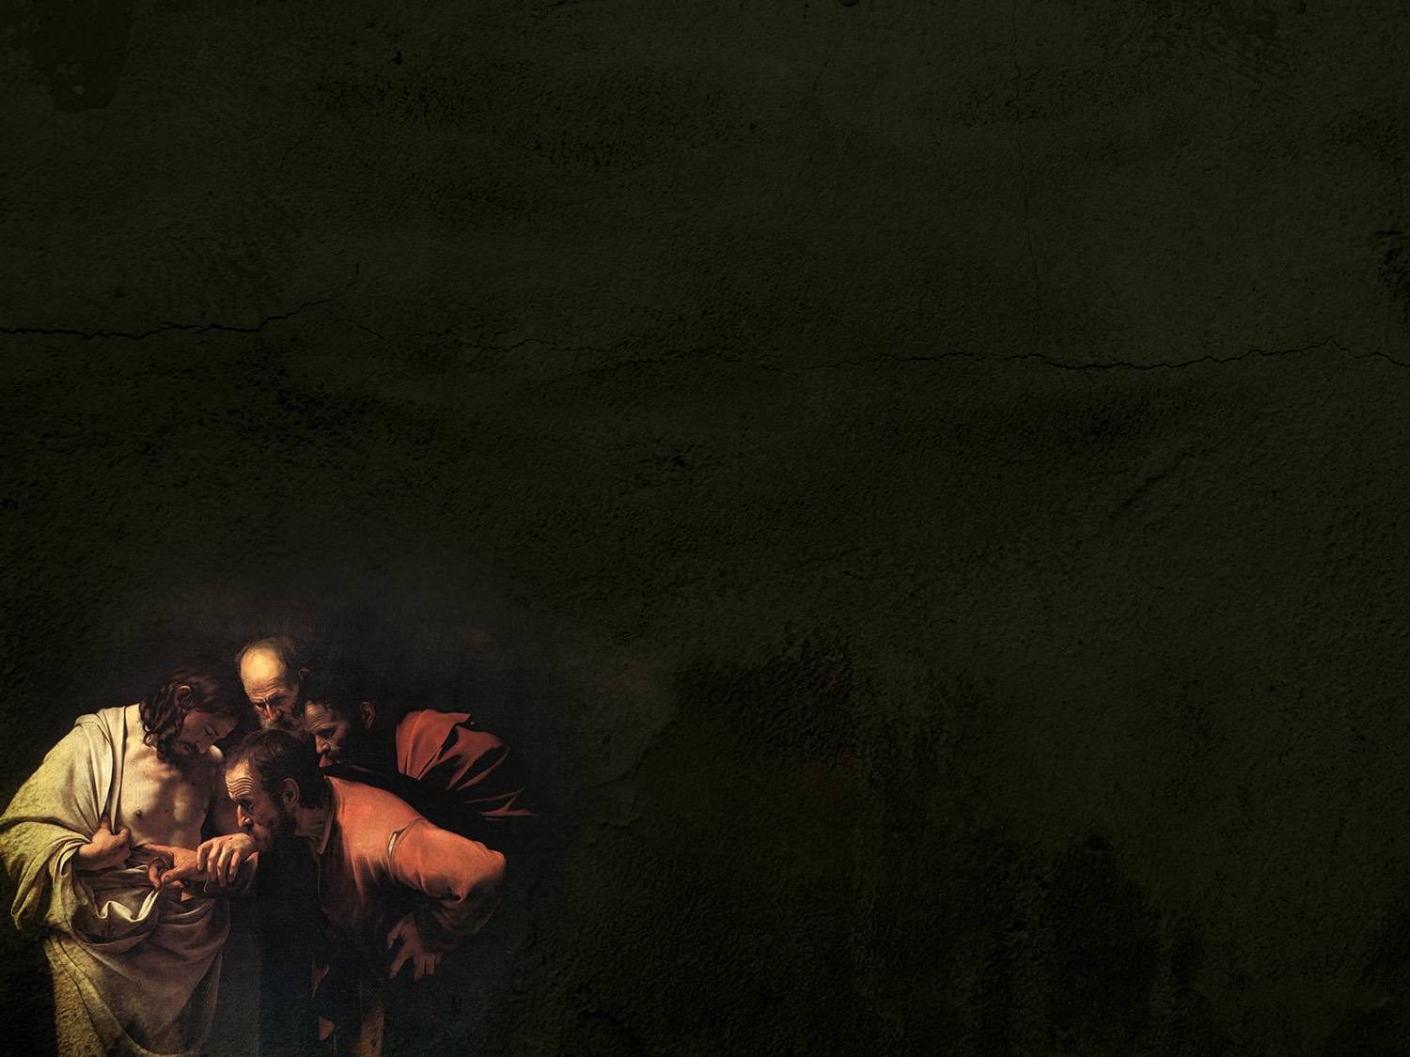
John 20:26-27
26 After eight days His disciples were again inside, and Thomas with them. Jesus came, the doors having been shut, and stood in their midst and said, "Peace be with you." 27 Then He said to Thomas, "Reach here with your finger, and see My hands; and reach here your hand and put it into My side; and do not be unbelieving, but believing." NASU

Slide 28
THOMAS
John 20:28
Thomas answered and said to Him, "My Lord and my God!” NASU

Slide 29
PETER
Matthew 16:15-16
¹⁵ He said to them, “But who do you say that I am?” ¹⁶ Simon Peter answered, “You are the Christ, the Son of the living God.”

Slide 30

Acts 1:21-22
21 "Therefore it is necessary that of the men who have accompanied us all the time that the Lord Jesus went in and out among us — 22 beginning with the baptism of John until the day that He was taken up from us — one of these must become a witness with us of His resurrection.” NASU

Slide 31
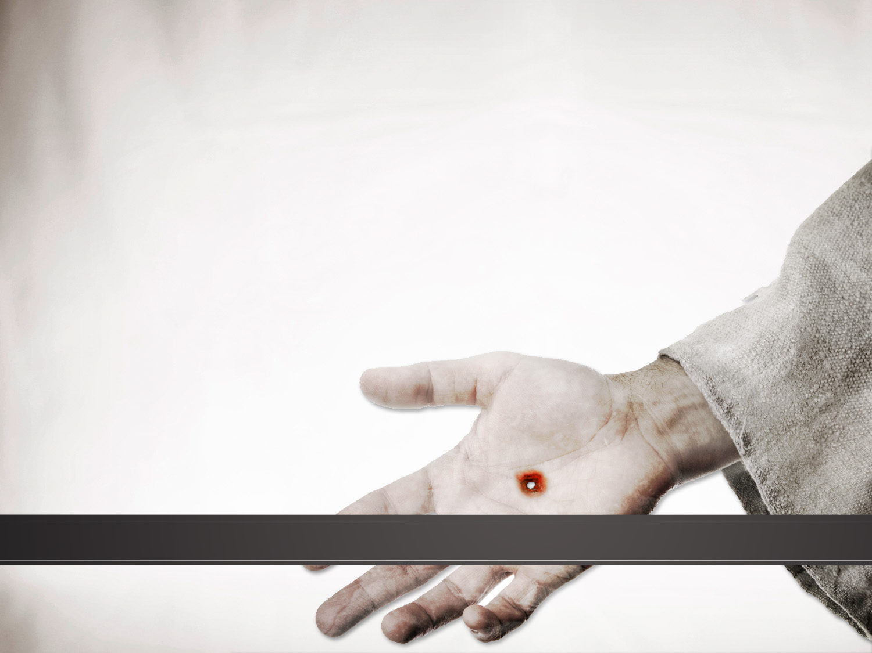
2 Peter 1:16
16 For we did not follow cleverly devised tales when we made known to you the power and coming of our Lord Jesus Christ, but we were eyewitnesses of His majesty.
NASU

Slide 32
THEIR TOUCH, OUR TRUST
1 John 1:1-4
1 What was from the beginning, what we have heard, what we have seen with our eyes, what we have looked at and touched with our hands, concerning the Word of Life — 2 and the life was manifested, and we have seen and testify and proclaim to you the eternal life, which was with the Father and was manifested to us — 3 what we have seen and heard we proclaim to you also, so that you too may have fellowship with us; and indeed our fellowship is with the Father, and with His Son Jesus Christ. 4 These things we write, so that our joy may be made complete. NASU

Slide 33
WHY DOESN’T GOD SHOW HIMSELF?
WHY DO I HAVE DOUBTS?
AM I DOING A GOOD JOB SO FAR?

Slide 34
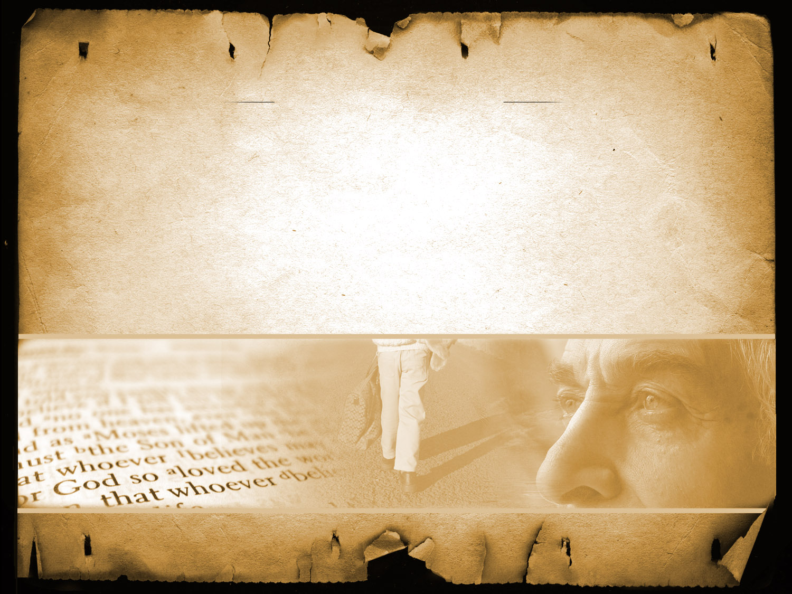
Jesus said to him, "Because you have seen Me, have you believed? Blessed are they who did not see, and yet believed.“ (20:29)
Seeing is not necessarily believing
Believing is seeing!

Slide 35
1 Peter 1:6 In this you greatly rejoice, even though now for a little while, if necessary, you have been distressed by various trials, ⁷ so that the proof of your faith, being more precious than gold which is perishable, even though tested by fire, may be found to result in praise and glory and honor at the revelation of Jesus Christ;

Slide 36
WHY DOESN’T GOD SHOW HIMSELF?
  Opportunity to see if faith is real!
WHY DO I HAVE DOUBTS?
  Satan is working to discourage you!
AM I DOING A GOOD JOB SO FAR?
  It is about direction, not perfection

Slide 37
Doubt not Desertion

Slide 38
TOOL: Remember who is happy when we doubt
TRAIT: Remember that the greatest heroes of faith had doubts
TRUST: There is a difference between doubting and deserting!

Slide 40
“Though He slay me, I will hope in Him” (Job 13:15)

