Slide 1


12 Questions: Evil and God
Mt. Juliet church of Christ
Mt. Juliet church of Christ
July 14, 2014
Dr. Ralph Gilmore

Slide 2
12 Questions:
WHY DOES GOD ALLOW EVIL?

Slide 3


Slide 4
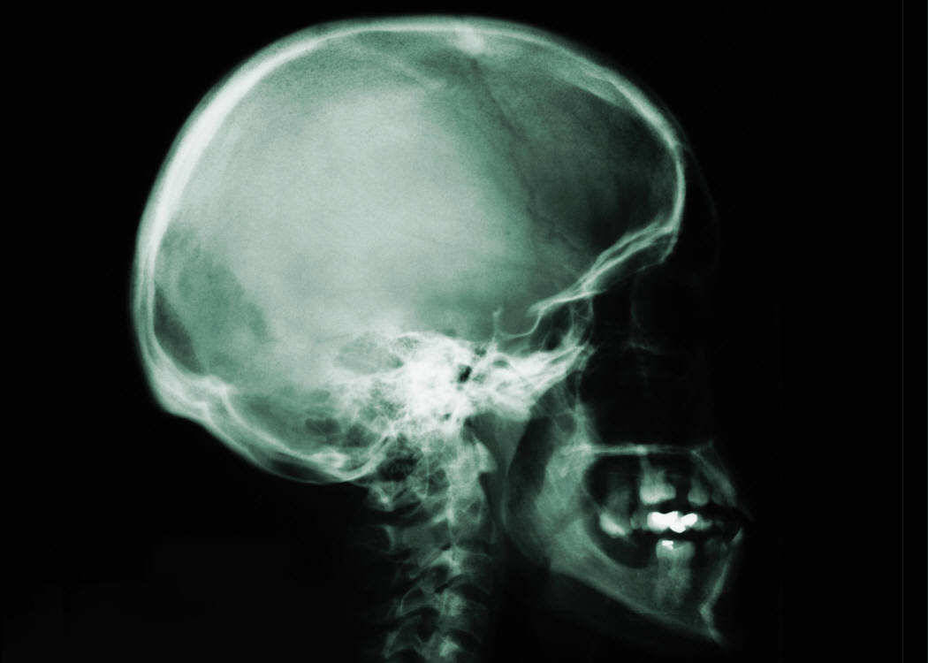
“HEAD” KNOWLEDGE

Slide 5

“HEART” KNOWLEDGE

Slide 6


The Problem of Evil
1. God is Omnipotent.
2. God is Omniscient.
3. God is Omni-benevolent.
4. Evil really exists.
The problem is not with one statement, but the sum of all four.

Slide 7
Christians should have a workable THEODICY (i.e., “a plan to make God just”).

Slide 8
The Problem of Evil
TO UNDERSTAND THE PROBLEM BETTER, WE WILL LOOK AT 4 AREAS:
GOD
MANKIND
EVIL
THE WORLD

Slide 9
The Problem of Evil
1. CONCERNING GOD

Slide 10
I. CONCERNING GOD
A. If "the omnipotence of God" means "being able to do anything I can think of," then he should be able to make humans free and not free at the same time.
This definition cannot work if for no other reason than the fact that the Bible says that God cannot lie (Tit. 1:2; Heb. 6:16-18).

Slide 11
A. The Omnipotence of God
If God could do whatever is imagined, then He should be able to make a free world in which it is impossible for sin to exist.
Alternative definition: “God can do anything that lends itself to accomplishment” (Warren, HAPTING).

Slide 12

B. THREE ASPECTS OF THE WILL OF GOD (Leslie G. Weatherhead, The Will of God)
IDEAL WILL ‑ 2 Pet. 3.9 "Not willing that any should perish"; 1 Tim. 2.3,4 ”God would have all men to be saved and to
come to a knowledge of the truth.” Can man defeat this aspect of the will of God? YES.
CIRCUMSTANTIAL OR CONDITIONAL WILL ‑ i.e., what God planned to do and has done in the circumstance of man's sin. Eph. 2,3; 2 Th. 1.5‑10; Jn. 3.16
Can man defeat this aspect of the will of God? YES.
ULTIMATE WILL ‑ the punishment of the wicked and the reward of the righteous. 2 Cor. 5.10; Heb. 9.27; Mt. 25.31‑46; Lk. 16.19‑31. Can man defeat this aspect of the will of God? NO.

Slide 13

C. The Theory of Retribution
1. I shall call this the Zap theory because it is based on the idea that if someone does evil, God will "zap" them with a disease, death, etc. It is called the
theory of retribution because many feel that it is
God's "pay back" for our sins.
2. On at least two occasions, Jesus responded
negatively to the prevailing Jewish view that evil
always comes as a result of our sins.
a. (Lk.13.1‑5) the slain Galilean worshipers and
the soldiers killed in a collapsed tower
b. (Jn. 9.1‑31) the man born blind

Slide 14
C. The Theory of Retribution
3. Even in Job's day, it was assumed that bad things
happen to people always because of their sins
[Job 4.7‑11 (Eliphaz); 8.1‑7 (Bildad); 11.1‑6
(Zophar)]. The Lord was not satisfied with what
Job's friends had said of God (Job 42.7‑9), and the Lord makes Job prosperous again (Job 42.10‑17).
4. Thus, the theory of retribution is false. But just
because one cannot say that God always sends
suffering because of one's sins, neither can one say
that mankind never suffers because of his sins
(1 Pet. 4.15,16; Ezek. 18.4‑20).

Slide 15

EXTREME NO. 1: GOD ALWAYS PUNISHES US IN THIS WORLD FOR OUR SINS

Slide 16
The Theory of Retribution: God punishes us in this world in degree AND quantity for our sins.

Slide 17
EXTREME NO. 2: GOD NEVER PUNISHES US IN THIS WORLD FOR OUR SINS

